Slide 1
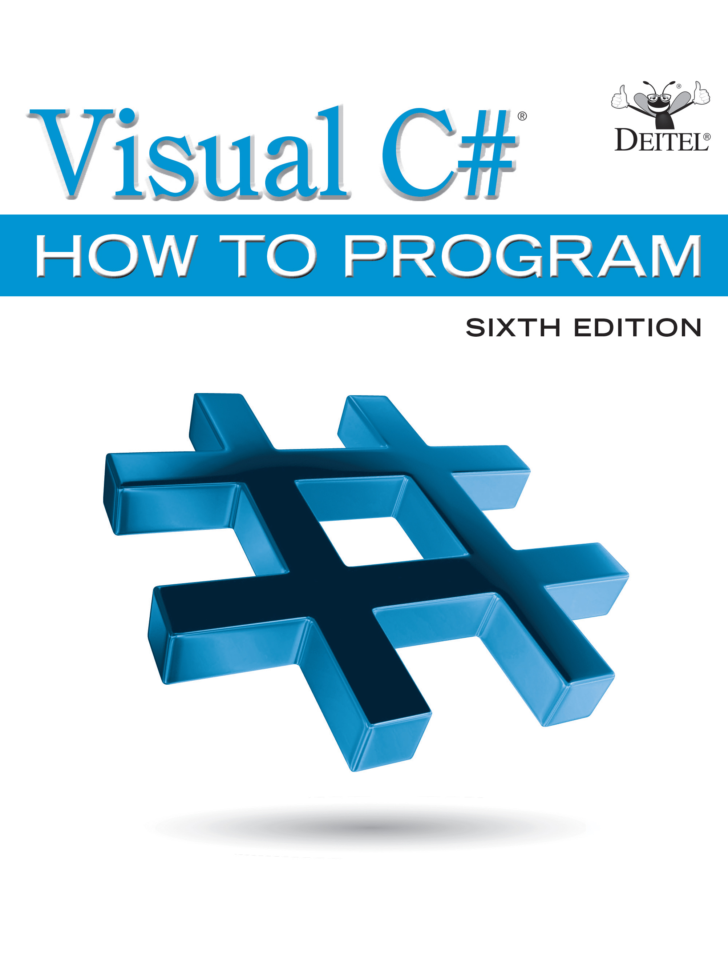
Visual C sharp® How to Program
Sixth Edition
Chapter 13
Exception Handling: A Deeper Look
Copyright © 2017 Pearson Education, Inc. All Rights Reserved
Notes:
If this PowerPoint presentation contains mathematical equations, you may need to check that your computer has the following installed:
1) MathType Plugin
2) Math Player (free versions available)
3) NVDA Reader (free versions available)

Slide 2
Learning Objectives (1 of 2)
Understand what exceptions are and how they’re handled.
Learn when to use exception handling.
Use try blocks to delimit code that may throw exceptions.
Use throw to indicate a problem at runtime.
Use catch blocks to specify exception handlers.
Understand what happens to uncaught exceptions.
Understand the mechanics of the termination model of exception handling.

Slide 3
Learning Objectives (2 of 2)
Use the finally block to release resources.
See how a using statement can auto-release resources.
Understand .NET exception class hierarchy.
Use Exception properties.
Create new exception types.
6’s null-conditional operator (?.) to determine whether a reference is null before using it to call a method or access a property.
Use nullable value types to specify that a variable may contain a value or null.
Use
Use
6 exception filters to specify a condition for catching an exception.

Slide 4
Outline (1 of 4)
13.1 Introduction
13.2 Example: Divide by Zero without Exception Handling
13.2.1 Dividing By Zero
13.2.2 Enter a Non-Numeric Denominator
13.2.3 Unhandled Exceptions Terminate the App
13.3 Example: Handling DivideByZeroExceptions and FormatExceptions
13.3.1 Enclosing Code in a try Block
13.3.2 Catching Exceptions
13.3.3 Uncaught Exceptions
13.3.4 Termination Model of Exception Handling

Slide 5
Outline (2 of 4)
13.3.5 Flow of Control When Exceptions Occur
13.4 .NET Exception Hierarchy
13.4.1 Class SystemException
13.4.2 Which Exceptions Might a Method Throw?
13.5 finally Block
13.5.1 Moving Resource-Release Code to a finally Block
13.5.2 Demonstrating the finally Block
13.5.3 Throwing Exceptions Using the throw Statement
13.5.4 Rethrowing Exceptions
13.5.5 Returning After a finally Block

Slide 6
Outline (3 of 4)
13.6 The using Statement
13.7 Exception Properties
13.7.1 Property InnerException
13.7.2 Other Exception Properties
13.7.3 Demonstrating Exception Properties and Stack Unwinding
13.7.4 Throwing an Exception with an InnerException
13.7.5 Displaying Information About the Exception
13.8 User-Defined Exception Classes

Slide 7
Outline (4 of 4)
13.9 Checking for null References; Introducing
Operator
13.9.1 Null-Conditional Operator (?.)
13.9.2 Revisiting Operators is and as
13.9.3 Nullable Types
13.9.4 Null Coalescing Operator (??)
13.10 Exception Filters and the
6 when Clause
13.11 Wrap-Up

Slide 8
13.1 Introduction
An exception is an indication of a problem that occurred during a program’s execution.
Exception handling enables you to create apps that can handle exceptions—in many cases allowing a program to continue executing as if no problems were encountered.
Exception handling enables you to write clear, robust and more fault-tolerant programs.

Slide 9
13.2 Example: Divide by Zero without Exception Handling (1 of 4)
Figure 13.1’s inputs two integers from the users, then divides the first integer by the second using integer division to obtain an int result.
In this example, an exception is thrown (i.e., an exception occurs) when a method detects a problem.

Slide 10
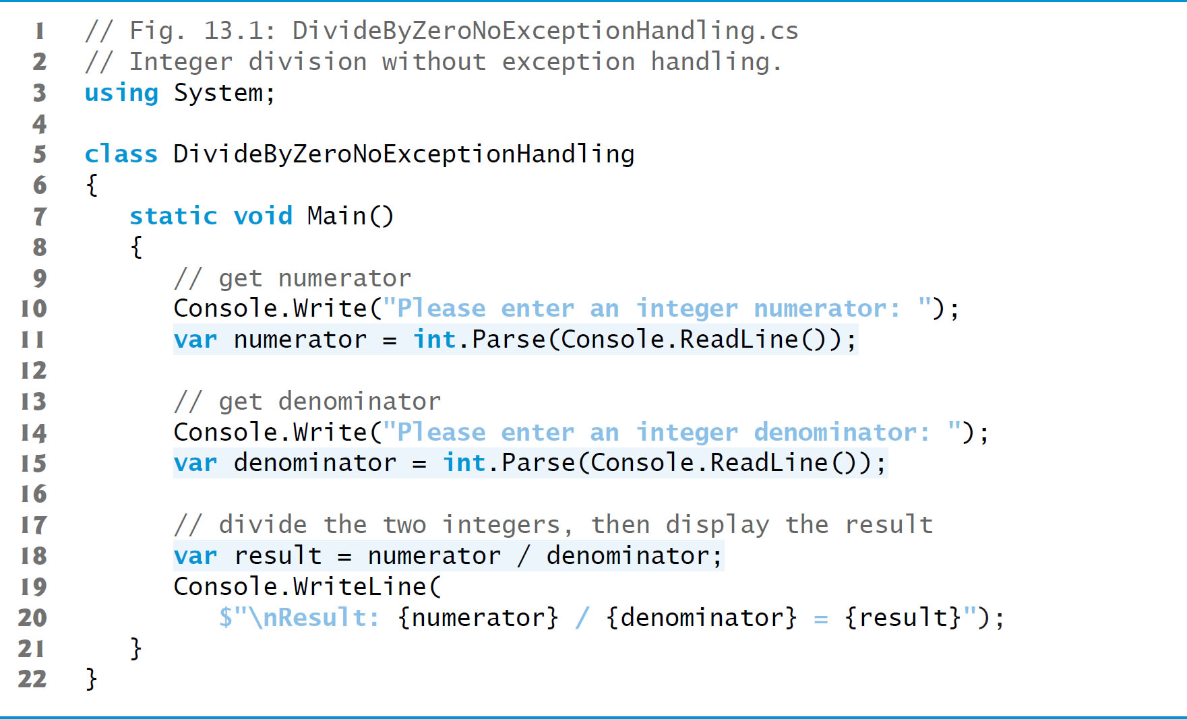
Figure 13.1 Integer Division Without Exception Handling (1 of 3)

Slide 11
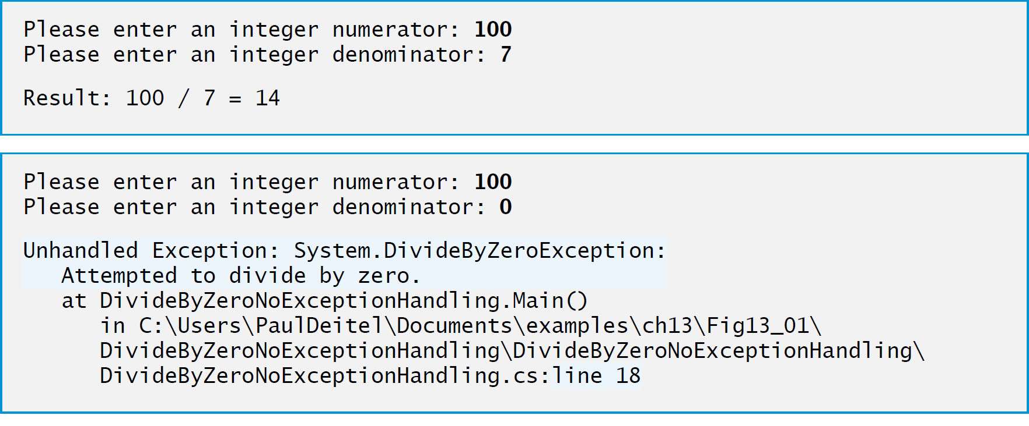
Figure 13.1 Integer Division Without Exception Handling (2 of 3)

Slide 12
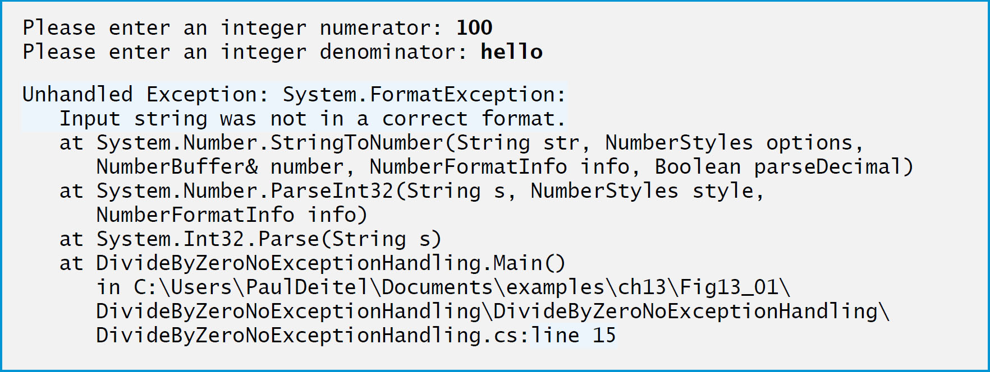
Figure 13.1 Integer Division Without Exception Handling (3 of 3)

Slide 13
13.2 Example: Divide by Zero without Exception Handling (2 of 4)
The example in Figure 13.1 (see slides 10) might cause exceptions, depending on the user’s input.
Execute this app with Debug → Start Without Debugging.
If an exception occurs during execution, a dialog appears indicating that the app “has stopped working.”
Click Cancel or Close Program to terminate the app.
An error message describing the exception that occurred is displayed in the program’s output.

Slide 14
13.2 Example: Divide by Zero without Exception Handling (3 of 4)
A stack trace includes the exception class’s name in a message indicating the problem that occurred and the path of execution that led to the exception, method by method.
Stack traces help you debug a program.
The first line of the error message specifies the exception that occurred.
When a program divides an integer by 0, the C L R throws a DivideByZeroException.
Division by zero is not allowed in integer arithmetic.

Slide 15
13.2 Example: Divide by Zero without Exception Handling (4 of 4)
A FormatException occurs when int.Parse receives a string that does not represent a valid integer.
This program terminates when an unhandled exception occurs.
This does not always happen—sometimes a program may continue executing even though an exception has occurred and a stack trace has been displayed.
In such cases, the app may produce incorrect results.

Slide 16
13.3 Example: HandlingDivideByZeroExceptions and FormatExceptions (1 of 2)
The app in Figure 13.2 uses exception handling to process DivideByZeroExceptions and FormatExceptions that might arise.
This program demonstrates how to catch and handle exceptions—in this case, displaying an error message and allowing the user to enter another set of values.

Slide 17
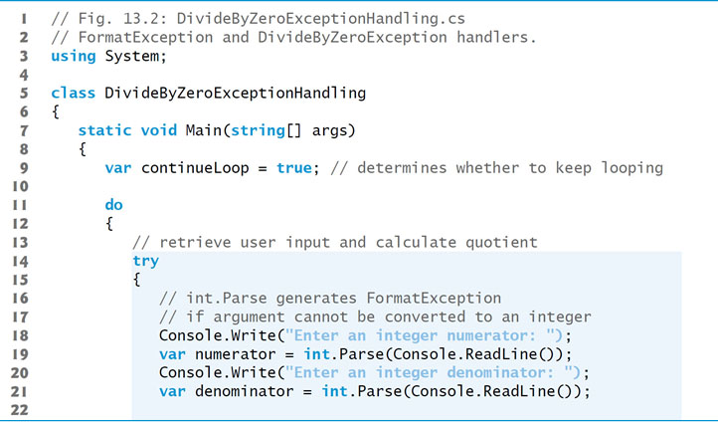
Figure 13.2 FormatException and DivideByZeroException handlers (1 of 4)

Slide 18
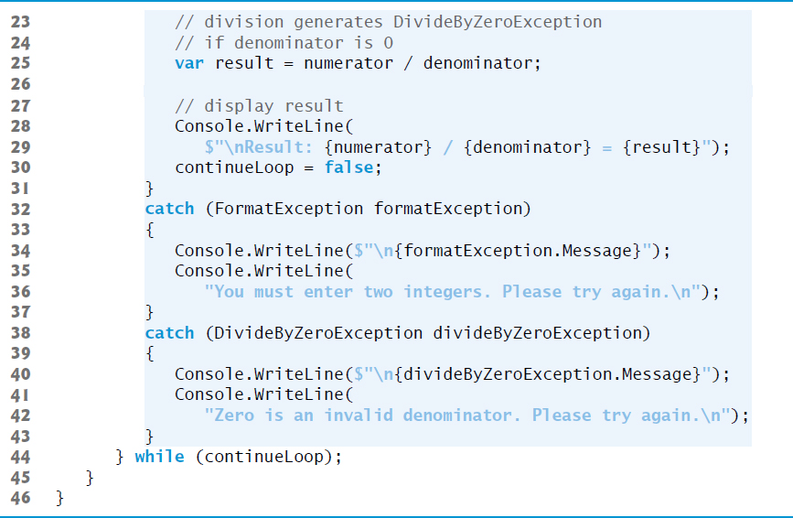
Figure 13.2 FormatException and DivideByZeroException handlers (2 of 4)

Slide 19
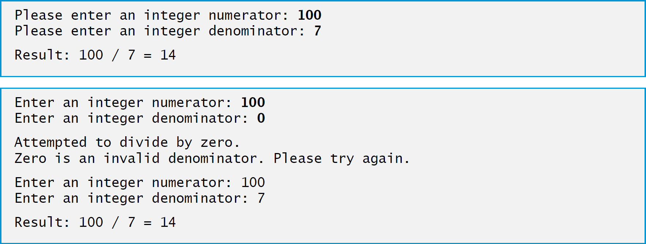
Figure 13.2 FormatException and DivideByZeroException handlers (3 of 4)

Slide 20
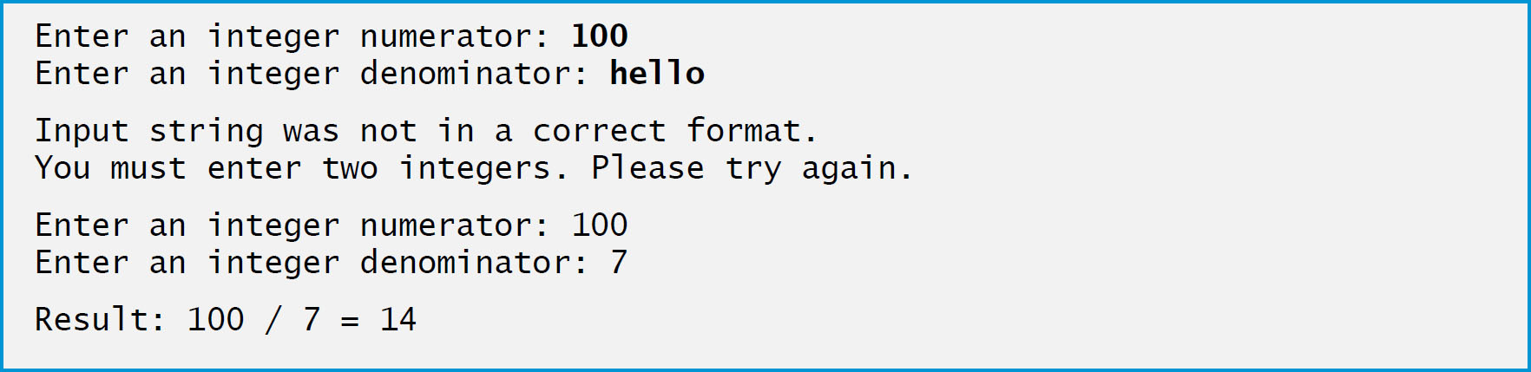
Figure 13.2 FormatException and DivideByZeroException handlers (4 of 4)

Slide 21
13.3 Example: Handling DivideByZeroExceptions and FormatExceptions (2 of 2)
The Int32.TryParse method converts a string to an int value if possible.
The method requires two arguments—one is the string to parse and the other is the variable in which the converted value is to be stored.
The method returns a bool value that’s true if the string was parsed successfully.
If the string could not be converted, the value 0 is assigned to the second argument.

Slide 22
Error-Prevention Tip 13.1
Method TryParse can be used to validate input in code rather than allowing the code to throw an exception—this technique is generally preferred.

Slide 23
13.3.1 Enclosing Code in a try Block
A try block encloses code that might throw exceptions, as well as the code that’s skipped when an exception occurs.

Slide 24
13.3.2 Catching Exceptions
When an exception occurs in a try block, a corresponding catch block catches the exception and handles it.
At least one catch block must immediately follow a try block.
A catch block specifies an exception parameter representing the exception that the catch block can handle.
Optionally, you can include a catch block that does not specify an exception type to catch all exception types.

Slide 25
13.3.3 Uncaught Exceptions
An uncaught exception (or unhandled exception) is an exception for which there is no matching catch block.
If you run the app by using Debug → Start Debugging and the runtime environment detects an uncaught exception, the app pauses, and the Exception Assistant (Figure 13.3) appears.

Slide 26
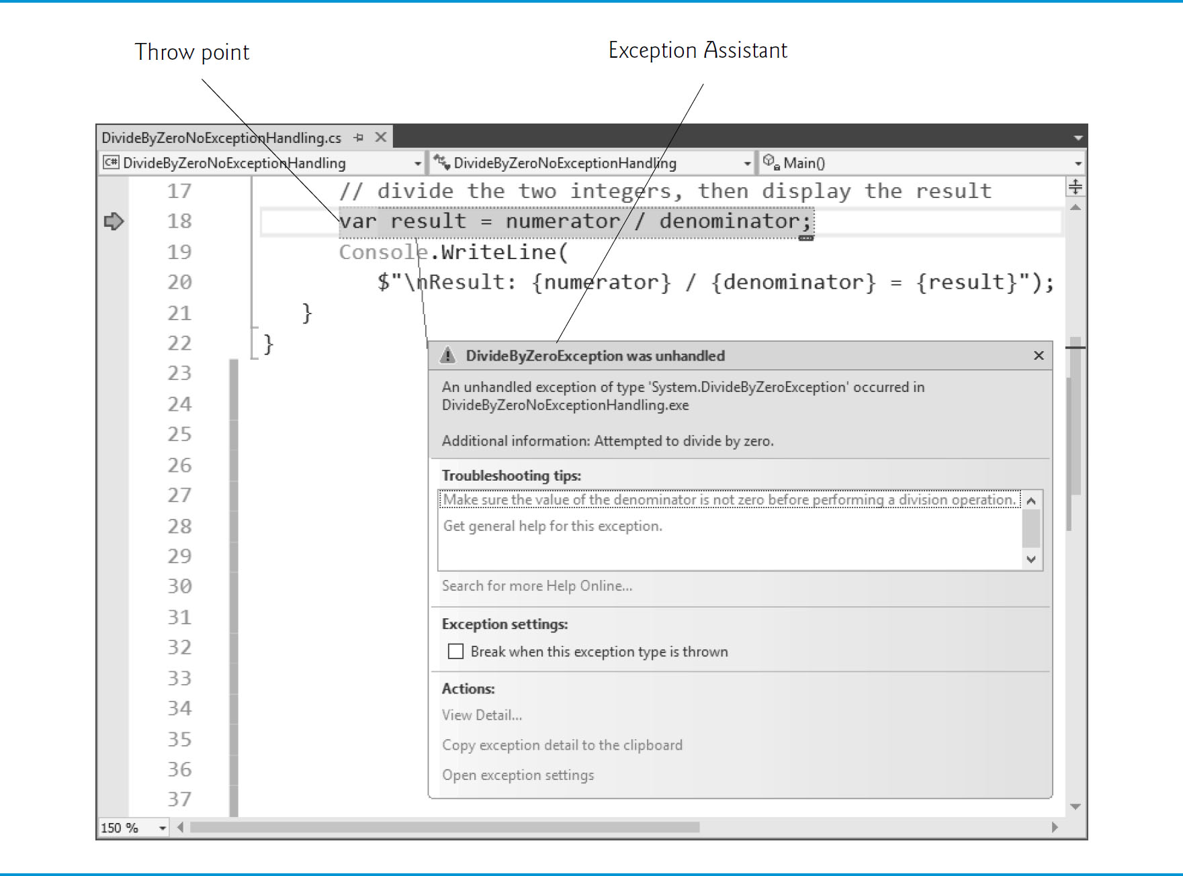
Figure 13.3 Exception Assistant

Slide 27
13.3.4 Termination Model of Exception Handling
The point at which an exception occurs is called the throw point.
If an exception occurs in a try block, program control immediately transfers to the first catch block matching the type of the thrown exception.
After the exception is handled, program control resumes after the last catch block.
This is known as the termination model of exception handling.

Slide 28
Common Programming Error 13.1
Specifying a comma-separated list of parameters in a catch block is a syntax error. A catch block can have at most one parameter. Section 13.10 shows how you can use exception filters to specify additional conditions for which an exception can be caught.

Slide 29
13.4 .NET Exception Hierarchy
In
only objects of class Exception and its derived classes may be thrown and caught.
Exceptions thrown in other .NET languages can be caught with the general catch clause.

Slide 30
13.4.1 Class SystemException (1 of 2)
Class Exception is the base class of .NET’s exception class hierarchy.
The C L R generates SystemExceptions.
If a program attempts to access an out-of-range array index, the C L R throws an exception of type IndexOutOfRangeException.
Attempting to use a null reference causes a NullReferenceException.

Slide 31
13.4.1 Class SystemException (2 of 2)
A catch block can use a base-class type to catch a hierarchy of related exception types.
A catch block that specifies a parameter of type Exception can catch all exceptions.
This technique makes sense only if the handling behavior is the same for a base class and all derived classes.

Slide 32
Common Programming Error 13.2
The compiler issues an error if a catch block that catches a base-class exception is placed before a catch block for any of that class’s derived-class types. In this case, the base-class catch block would catch all base-class and derived-class exceptions, so the derived-class exception handler would never execute.

Slide 33
13.4.2 Which Exceptions Might a Method Throw?
Search for “int.Parse method” in the Visual Studio online documentation.
The Exceptions section of this method’s web page indicates that method int.Parse throws exception types
ArgumentNullException
FormatException
OverflowException
and describes the reason for each.

Slide 34
Software Engineering Observation 13.1
If a method may throw exceptions, statements that invoke the method directly or indirectly should be placed in try blocks, and those exceptions should be caught and handled.

Slide 35
13.5 finally Block (1 of 2)
Programs frequently request and release resources dynamically.
Operating systems typically prevent more than one program from manipulating a file.
Therefore, the program should close the file (i.e., release the resource) so other programs can use it.
If the file is not closed, a resource leak occurs.

Slide 36
Error-Prevention Tip 13.2
The C L R does not completely eliminate memory leaks. It will not garbage-collect an object until the program contains no more references to that object, and even then there may be a delay until the memory is required. Thus, memory leaks can occur if you inadvertently keep references to unwanted objects.

Slide 37
13.5.1 Moving Resource-Release Code to a finally Block
Exceptions often occur when an app processes resources that require explicit release.
Regardless of whether a program experiences exceptions, the program should close the file when it is no longer needed.
provides the finally block, which is guaranteed to execute regardless of whether an exception occurs.
This makes the finally block ideal to release resources from the corresponding try block.

Slide 38
13.5 finally Block (2 of 2)
Local variables in a try block cannot be accessed in the corresponding finally block, so variables that must be accessed in both should be declared before the try block.

Slide 39
Error-Prevention Tip 13.3
A finally block typically contains code to release resources acquired in the corresponding try block, which makes the finally block an effective mechanism for eliminating resource leaks.

Slide 40
Performance Tip 13.1
As a rule, resources should be released as soon as they’re no longer needed in a program. This makes them available for reuse promptly.

Slide 41
13.5.2 Demonstrating the finally Block
The app in Figure 13.4 demonstrates that the finally block always executes, regardless of whether an exception occurs in the corresponding try block.

Slide 42
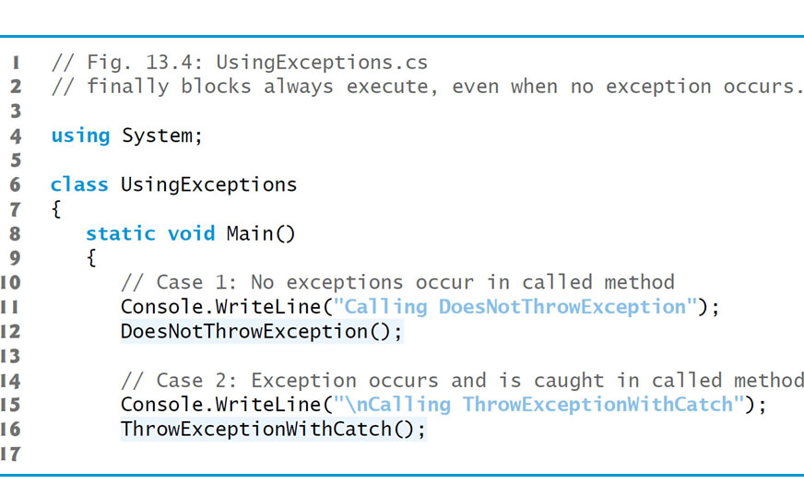
Figure 13.4 finally Blocks Always Execute, Even When No Exception Occurs (1 of 9)

Slide 43
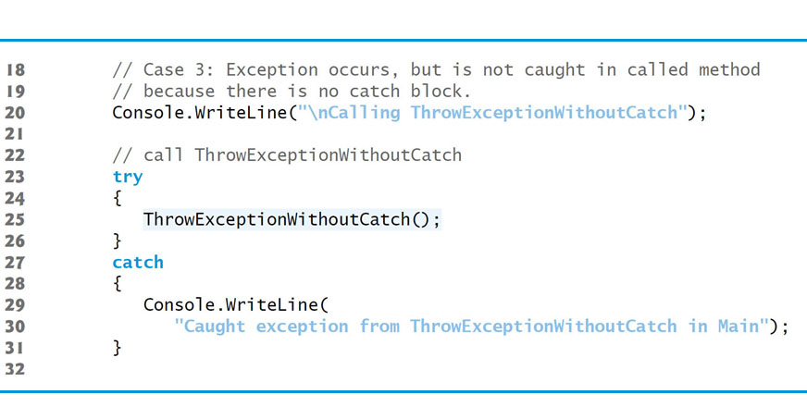
Figure 13.4 finally Blocks Always Execute, Even When No Exception Occurs (2 of 9)

Slide 44
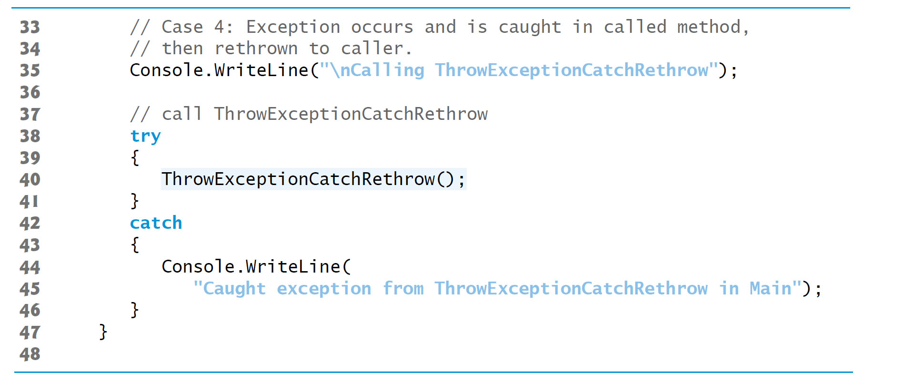
Figure 13.4 finally Blocks Always Execute, Even When No Exception Occurs (3 of 9)

Slide 45
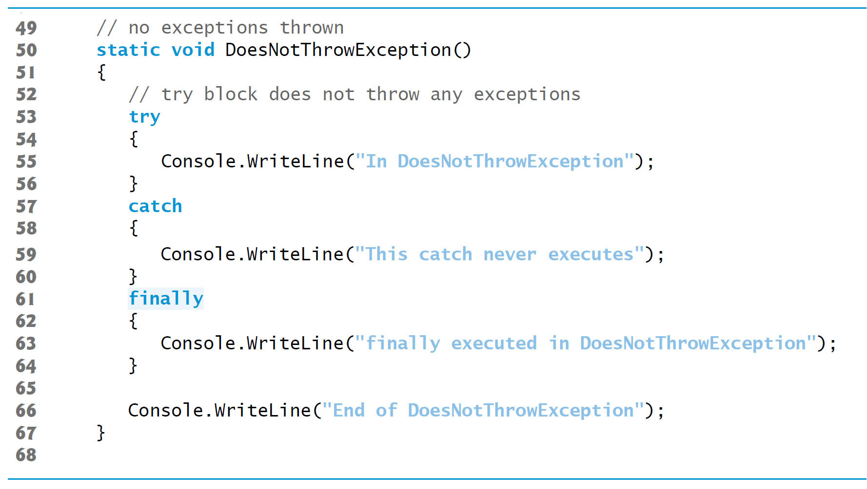
Figure 13.4 finally Blocks Always Execute, Even When No Exception Occurs (4 of 9)

Slide 46
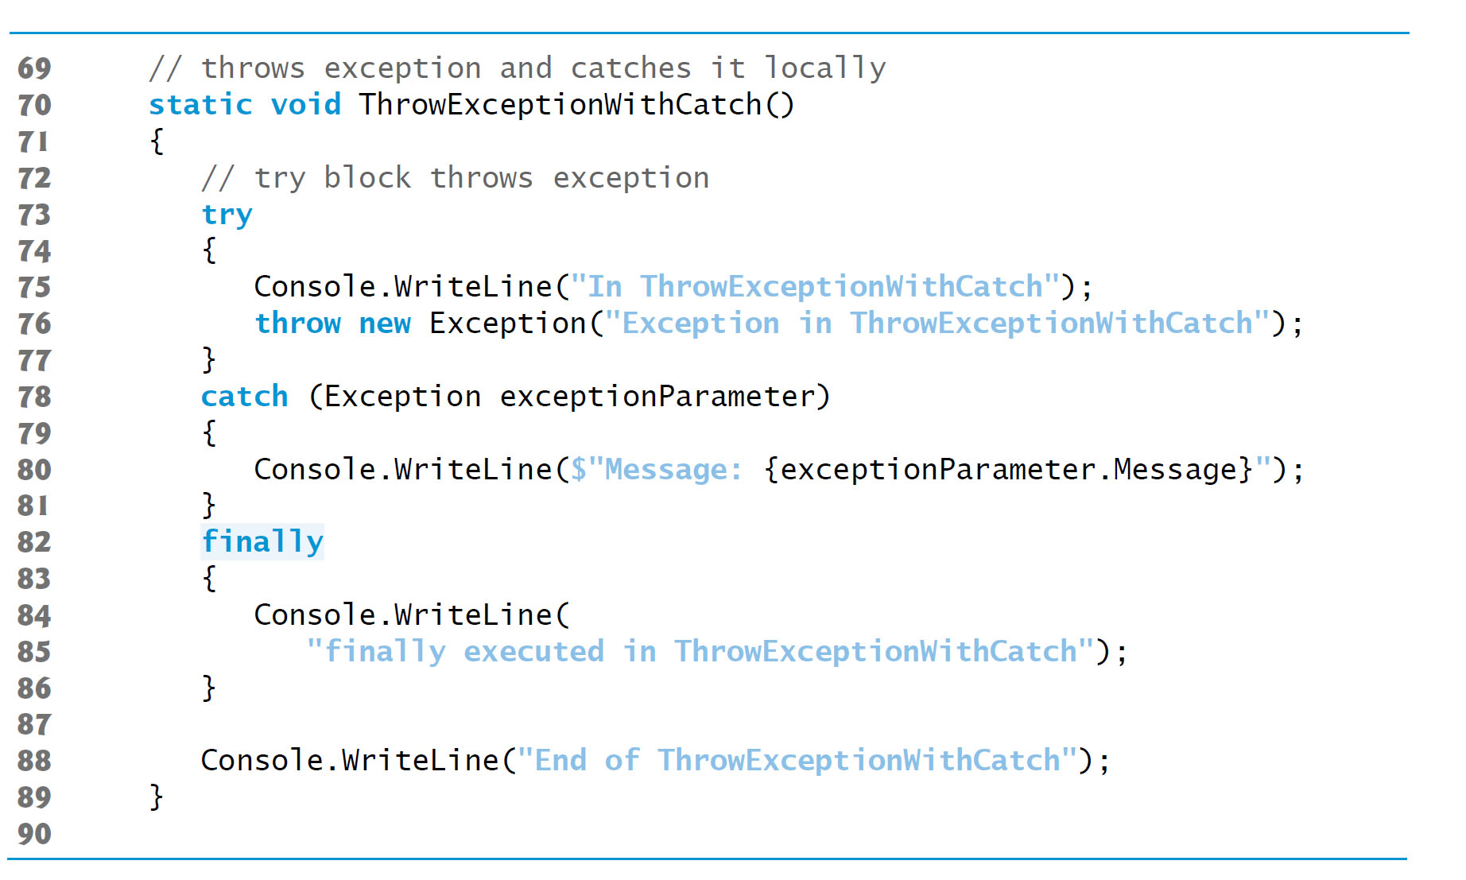
Figure 13.4 finally Blocks Always Execute, Even When No Exception Occurs (5 of 9)

Slide 47
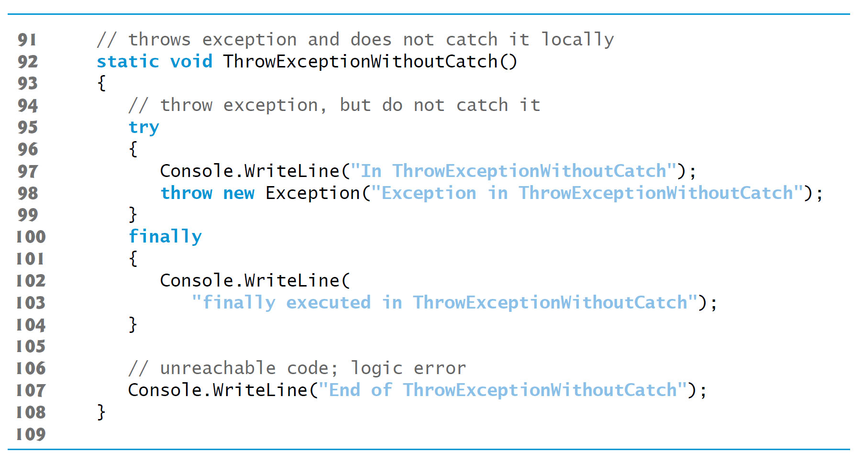
Figure 13.4 finally Blocks Always Execute, Even When No Exception Occurs (6 of 9)

Slide 48
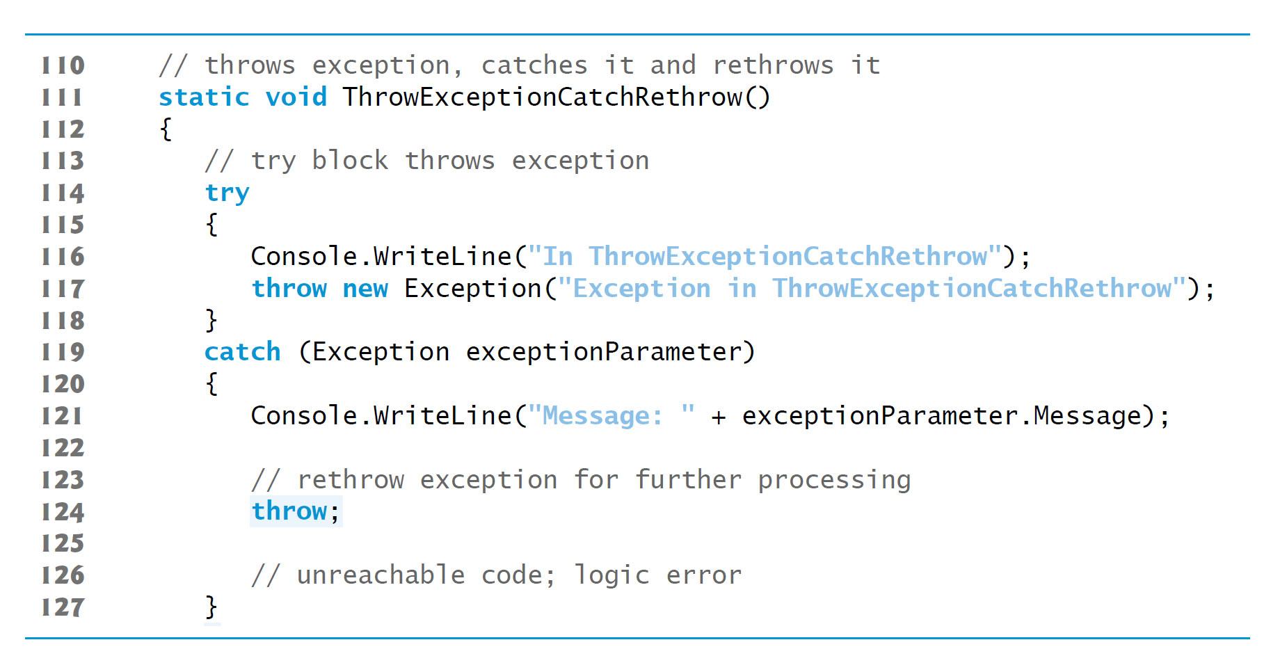
Figure 13.4 finally Blocks Always Execute, Even When No Exception Occurs (7 of 9)

Slide 49
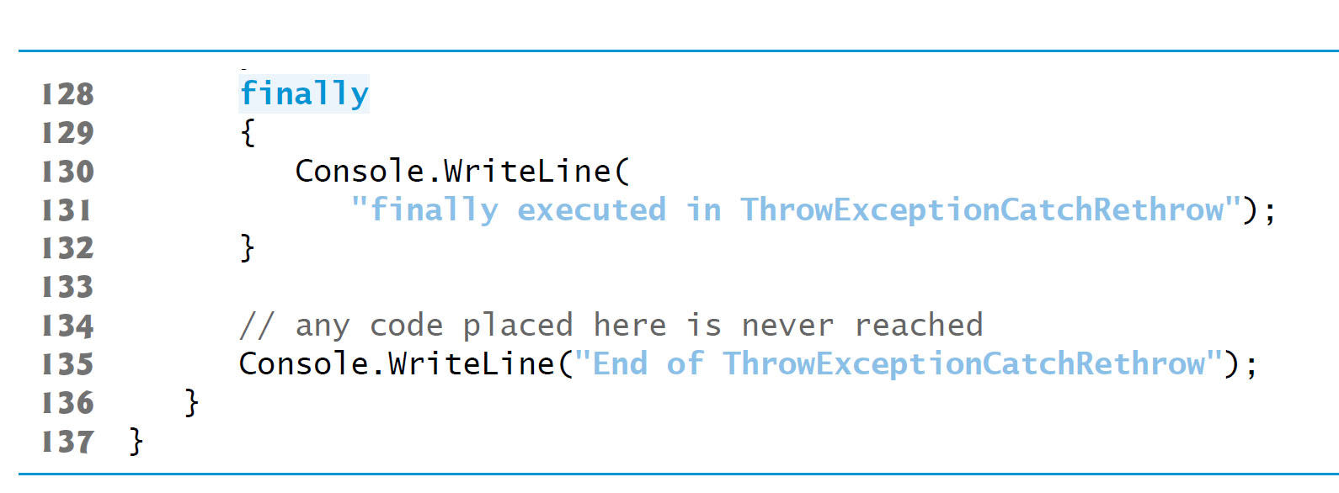
Figure 13.4 finally Blocks Always Execute, Even When No Exception Occurs (8 of 9)

Slide 50
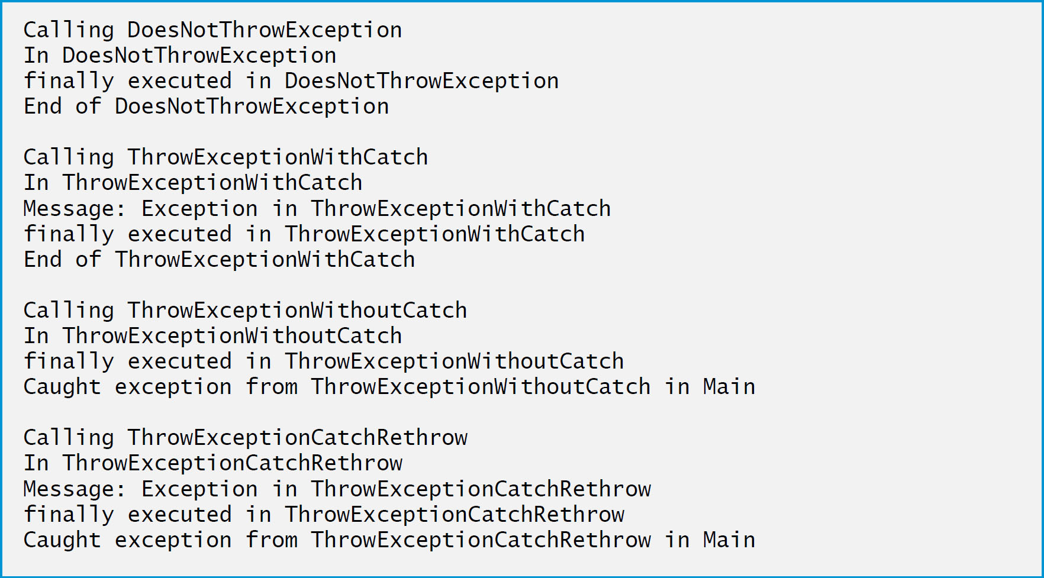
Figure 13.4 finally Blocks Always Execute, Even When No Exception Occurs (9 of 9)

Slide 51
13.5.3 Throwing Exceptions Using the throw Statement
You create and throw an exception with the throw statement
Executing the throw statement indicates that a problem has occurred in the code.
A throw statement specifies an object to be thrown. The operand of a throw statement can be of type Exception or of any type derived from class Exception.

Slide 52
13.5.4 Rethrowing Exceptions
You also can rethrow an exception with a version of the throw statement which takes an operand that’s the reference to the exception that was caught.
This form of throw statement resets the throw point, so the original throw point’s stack-trace information is lost.
Later, you’ll see that after an exception is caught, you can create and throw a different type of exception object from the catch block and you can include the original exception as part of the new exception object.
Class library designers often do this to customize the exception types thrown from methods in their class libraries or to provide additional debugging information

Slide 53
Software Engineering Observation 13.2
In general, it’s considered better practice to throw a new exception and pass the original one to the new exception’s constructor, rather than rethrowing the original exception. This maintains all of the stack-trace information from the original exception. We demonstrate passing an existing exception to a new exception’s constructor in Section 13.7.3.

Slide 54
13.5.5 Returning After a finally Block
If a try block successfully completes, or if a catch block catches and handles an exception, the program continues its execution with the next statement after the finally block.
If an exception is not caught, or if a catch block rethrows an exception, program control continues in the next enclosing try block.
The enclosing try could be in the calling method or in one of its callers.
It also is possible to nest a try statement in a try block; in such a case, the outer try statement’s catch blocks would process any exceptions that were not caught in the inner try statement.
If a try block executes and has a corresponding finally block, the finally block executes even if the try block terminates due to a return statement.
The return occurs after the execution of the finally block.

Slide 55
Common Programming Error 13.3
If an uncaught exception is awaiting processing when the finally block executes, and the finally block throws a new exception that’s not caught in the finally block, the first exception is lost, and the new exception is passed to the next enclosing try block.

Slide 56
Error-Prevention Tip 13.4
When placing code that can throw an exception in a finally block, always enclose the code in a try statement that catches the appropriate exception types. This prevents the loss of any uncaught and rethrown exceptions that occur before the finally block executes.

Slide 57
Software Engineering Observation 13.3
Do not place try blocks around every statement that might throw an exception—this can make programs difficult to read. Instead, place one try block around a significant portion of code, and follow this try block with catch blocks that handle each possible exception. Then follow the catch blocks with a single finally block. Use separate try blocks to distinguish between multiple statements that can throw the same exception type.

Slide 58
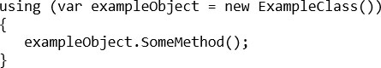
13.6 The using Statement (1 of 2)
The using statement simplifies writing code in which you obtain a resource.
The general form of a using statement is:

Slide 59
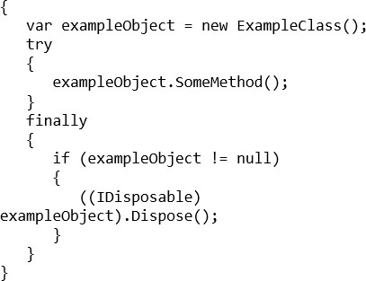
13.6 The using Statement (2 of 2)
The using statement code is equivalent to

Slide 60
13.7 Exception Properties
Class Exception’s properties are used to formulate error messages indicating a caught exception.
Property Message stores the error message associated with an Exception object.
Property StackTrace contains a string that represents the method-call stack.
If the debugging information that’s generated by the compiler for the method is accessible to the I D E, the stack trace also includes line numbers; the first line number indicates the throw point, and subsequent line numbers indicate the locations from which the methods in the stack trace were called.
The I D E creates P D B files to maintain the debugging information for your projects.

Slide 61
13.7.1 Property InnerException
When an exception occurs, a programmer might use a different error message or indicate a new exception type.
The original exception object is stored in the InnerException property.

Slide 62
13.7.2 Other Exception Properties
Class Exception provides other properties:
HelpLink specifies the location of a help file that describes the problem.
Source specifies the name of the app or object that caused the exception.
TargetSite specifies the method where the exception originated.

Slide 63
13.7.3 Demonstrating Exception Properties and Stack Unwinding
Figure 13.5 demonstrates properties of class Exception.

Slide 64
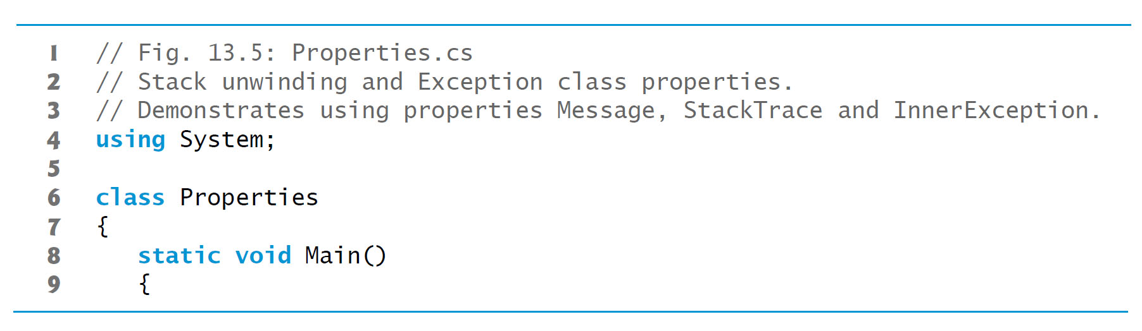
Figure 13.5 Stack Unwinding and Exception Class Properties (1 of 6)

Slide 65
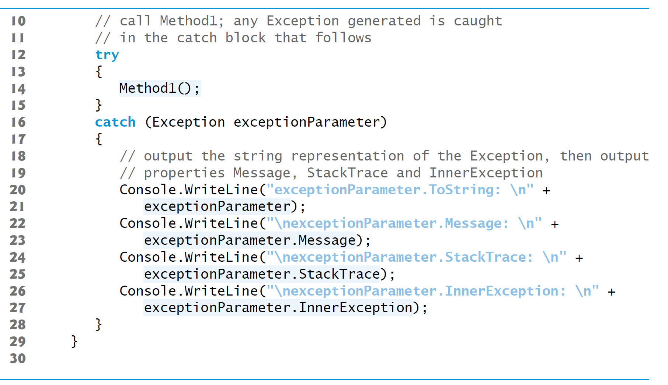
Figure 13.5 Stack Unwinding and Exception Class Properties (2 of 6)

Slide 66
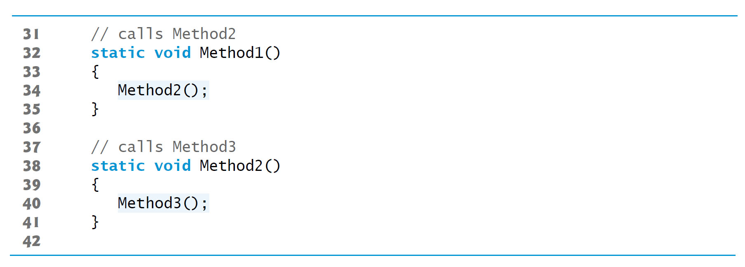
Figure 13.5 Stack Unwinding and Exception Class Properties (3 of 6)

Slide 67
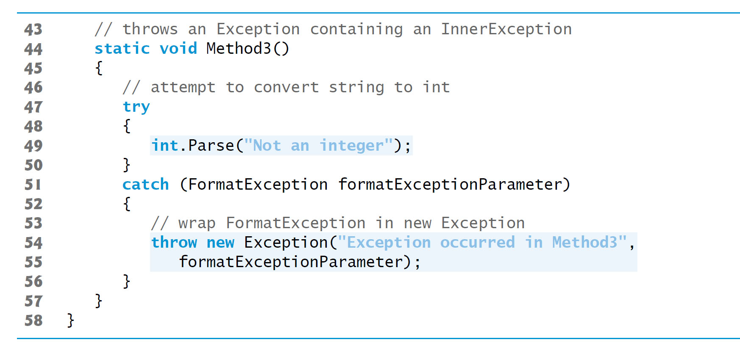
Figure 13.5 Stack Unwinding and Exception Class Properties (4 of 6)

Slide 68
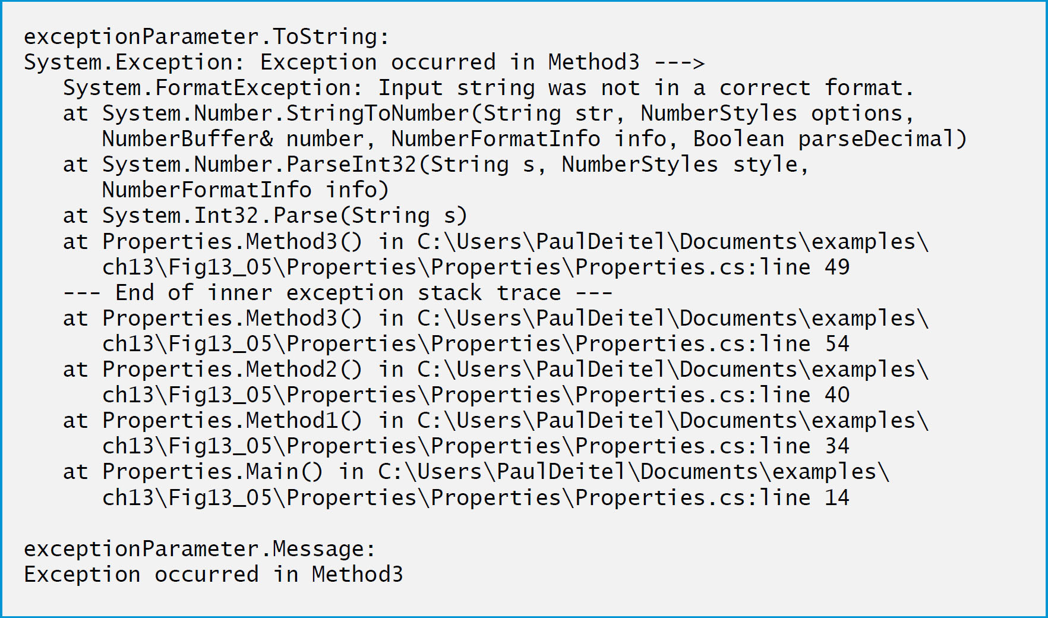
Figure 13.5 Stack Unwinding and Exception Class Properties (5 of 6)

Slide 69
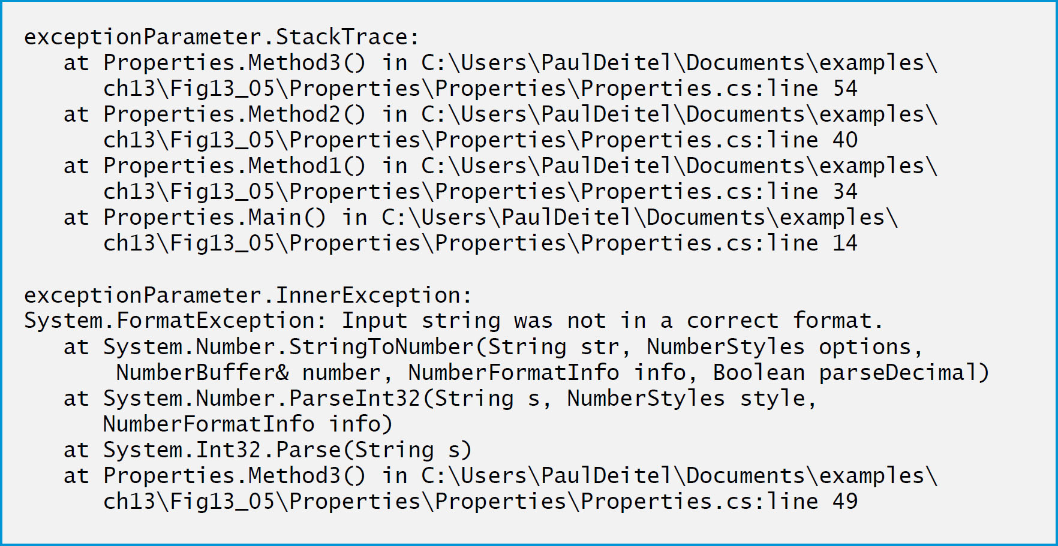
Figure 13.5 Stack Unwinding and Exception Class Properties (6 of 6)

Slide 70
13.7.4 Throwing an Exception With an InnerException
The Exception class’s two-argument constructor receives
the custom error message and the
InnerException to provide as additional information

Slide 71
13.7.5 Displaying Information About the Exception
Exception method ToString returns a string that begins with the name of the exception class followed by the Message property value.
The next items present the stack trace of the InnerException object.
The remainder of the block of output shows the StackTrace for the exception.
The StackTrace represents the state of the method-call stack at the throw point of the exception, rather than at the point where the exception eventually is caught.
Each StackTrace line that begins with “at” represents a method on the call stack.
These indicate the method in which the exception occurred, the file in which the method resides and the line number of the throw point in the file. The inner-exception information includes the inner-exception stack trace.

Slide 72
Error-Prevention Tip 13.5
When catching and rethrowing an exception, provide additional debugging information in the rethrown exception. To do so, create an object of an Exception subclass containing more specific debugging information, then pass the original caught exception to the new exception object’s constructor to initialize the InnerException property.

Slide 73
13.8 User-Defined Exception Classes (1 of 3)
In some cases, you might create exception classes specific to the problems that occur in your programs.
User-defined exception classes should derive directly or indirectly from class Exception.
Exceptions should be documented so that other developers will know how to handle them.

Slide 74
13.8 User-Defined Exception Classes (2 of 3)
Class NegativeNumberException
Figures 13.6 (see slides 78)–13.7 (see slides 80) demonstrate a user-defined exception class. User-defined exceptions should define three constructors:
a parameterless constructor
a constructor that receives a string argument (the error message)
a constructor that receives a string argument and an Exception argument (the error message and the inner exception object)

Slide 75
Good Programming Practice 13.1
Associating each type of malfunction with an appropriately named exception class improves program clarity.

Slide 76
Software Engineering Observation 13.4
Before creating a user-defined exception class, investigate the existing exceptions in the .NET Framework Class Library to determine whether an appropriate exception type already exists.

Slide 77
13.8 User-Defined Exception Classes (3 of 3)
NegativeNumberException (Figure 13.6) represents exceptions that occur when a program performs an illegal operation on a negative number, such as attempting to calculate its square root.
Class SquareRootTest (Figure 13.7 see slide 80) demonstrates our user-defined exception class.

Slide 78
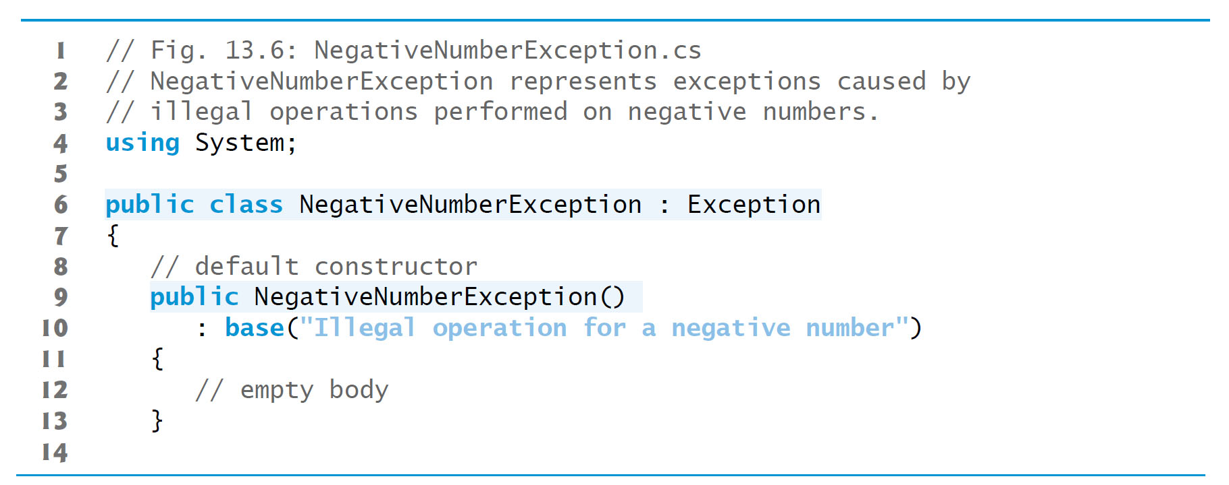
Figure 13.6 NegativeNumberException Represents Exceptions Caused by Illegal Operations Performed on Negative Numbers (1 of 2)

Slide 79
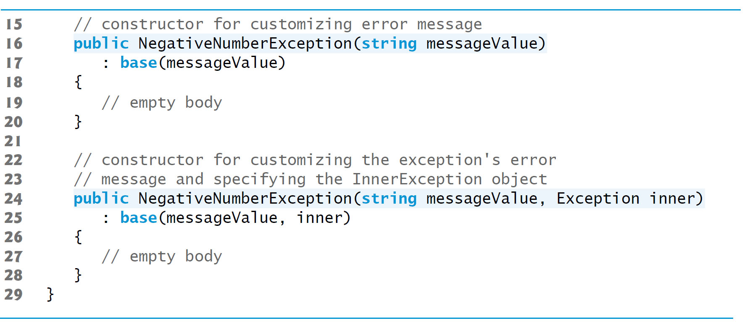
Figure 13.6 NegativeNumberException Represents Exceptions Caused by Illegal Operations Performed on Negative Numbers (2 of 2)

Slide 80
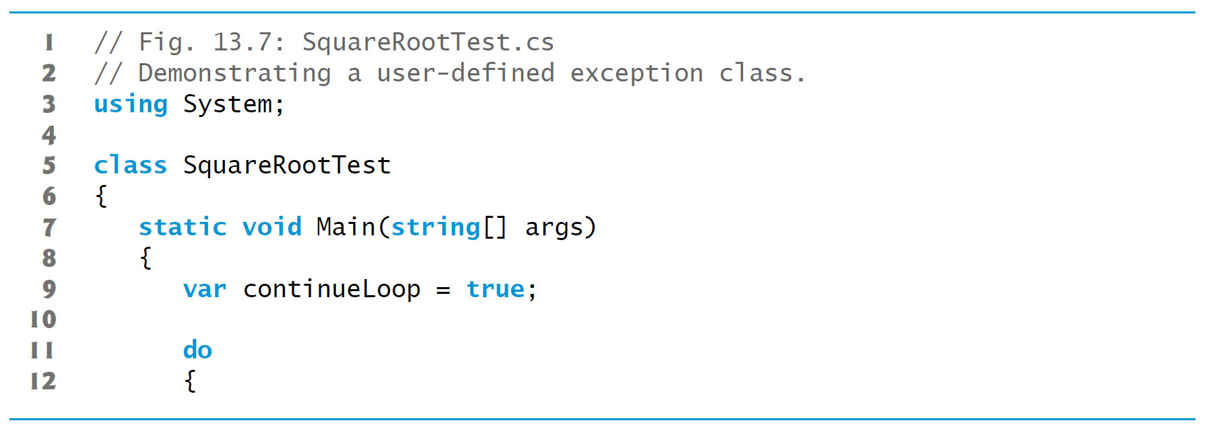
Figure 13.7 Demonstrating a User-Defined Exception Class (1 of 4)

Slide 81
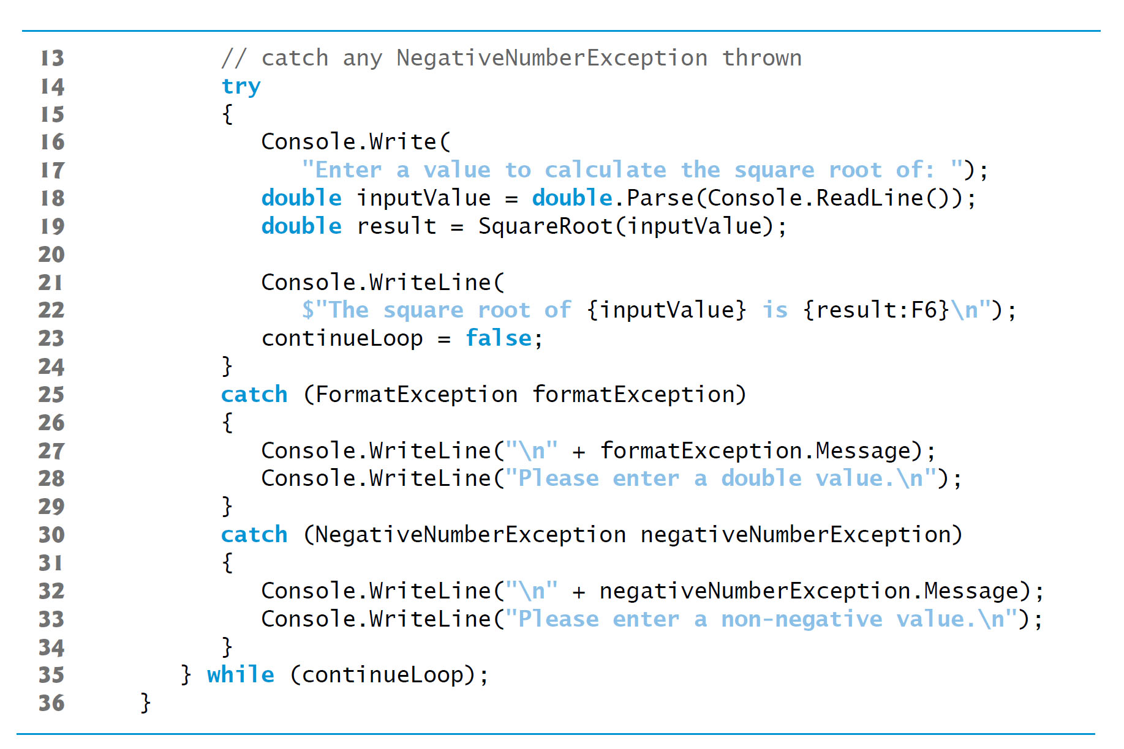
Figure 13.7 Demonstrating a User-Defined Exception Class (2 of 4)

Slide 82
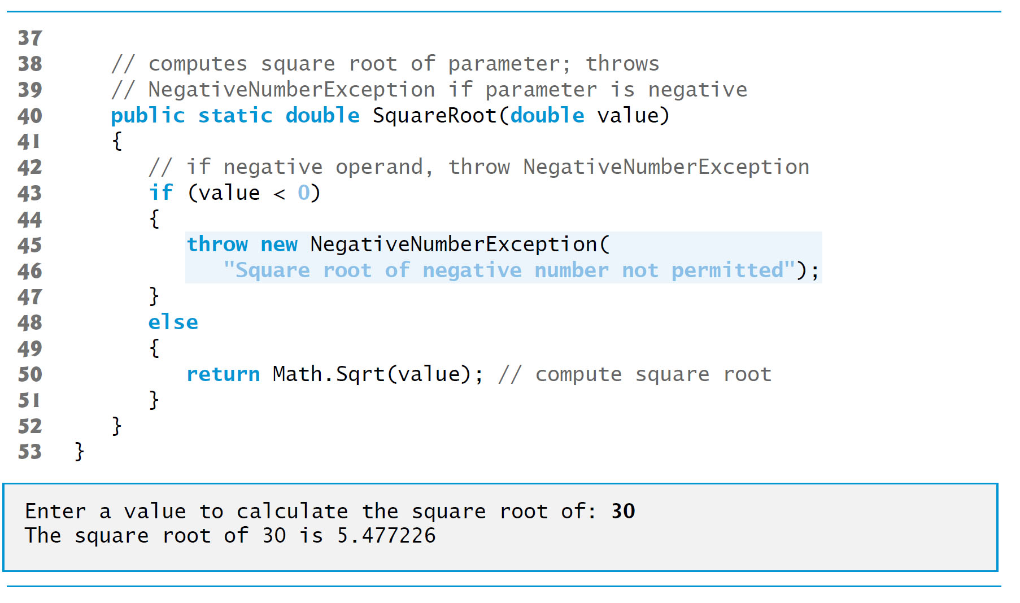
Figure 13.7 Demonstrating a User-Defined Exception Class (3 of 4)

Slide 83
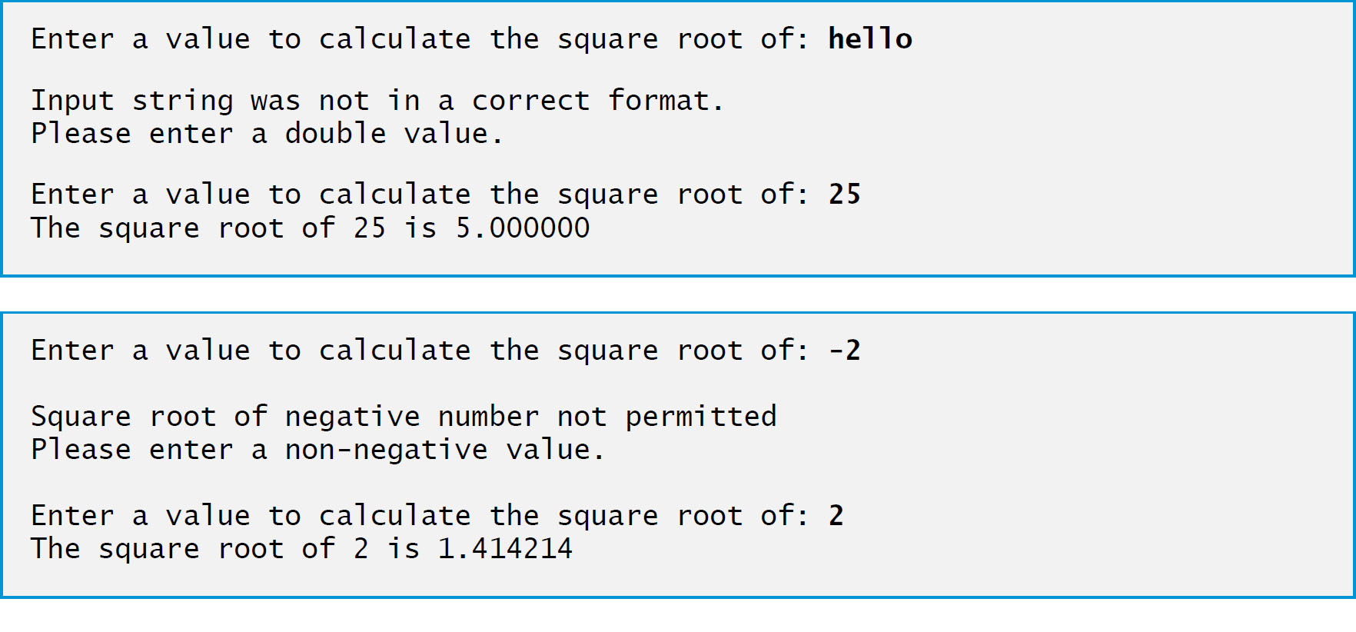
Figure 13.7 Demonstrating a User-Defined Exception Class (4 of 4)

Slide 84
13.9 Checking for null References; Introducing C sharp 6’s ?. Operator
Checking whether a reference is null before using it to call a method or access a property avoids NullReferenceExceptions.

Slide 85
Error-Prevention Tip 13.6
Always ensure that a reference is not null before using it to call a method or access a property of an object.

Slide 86
13.9.1 Null-Conditional Operator (?.)
6’s new null-conditional operator (?.) provides an elegant way to check for null.
The following statement calls Dispose only if exampleObject is not null
This eliminates the need to wrap the statement in and if statement that checks exampleObject to see if it’s null

Slide 87
13.9.2 Revisiting Operators is and as
Downcasting with operator is can cause InvalidCastExceptions.
You can avoid the InvalidCastException by using the as operator:
var employee = currentEmployee as BasePlusCommissionEmployee;
If currentEmployee is a BasePlusCommissionEmployee, employee is assigned the BasePlusCommissionEmployee; otherwise, it’s assigned null.
employee could be null, so you must check before using it.
For example, to give the BasePlusCommissionEmployee a 10% raise, we could use the following statement, which accesses and modifies the BaseSalary property only if employee is not null

Slide 88
13.9.3 Nullable Types (1 of 2)
Suppose you’d like to capture the value of
This statement actually results in a compilation error indicating that you cannot implicitly convert type decimal? to type decimal.
Normally a value-type variable cannot be assigned null.
Because the employee reference might be null, the expression returns a nullable type—a value type that also can be null.
You specify a nullable type by following a value type’s name with a question mark (?)—so decimal? represents a nullable decimal.
indicates that salary either will be null or the employee’s BaseSalary.

Slide 89
13.9.3 Nullable Types (2 of 2)
Nullable types have the following capabilities:
The GetValueOrDefault method checks whether a nullable-type variable contains a value. If so, the method returns that value; otherwise, it returns the value type’s default value.
An overload of this method receives one argument that enables you to specify a custom default value.
The HasValue property returns true if a nullable-type variable contains a value; otherwise, it returns false.
The Value property returns the nullable-type variable’s underlying value or throws an InvalidOperationException if the underlying value is null.
Variables of nullable types also may be used as the left operand of the null-conditional operator (?.) or the null coalescing operator (??).

Slide 90
Error-Prevention Tip 13.7
Before using a nullable-type variable’s Value property, use the HasValue property to check whether the variable has a value. If the nullable-type variable is null, accessing Value results in an InvalidOperationException.

Slide 91
13.9.4 Null Coalescing Operator (??) (1 of 2)
also offers the null coalescing operator (??) for working with values that can be null.
The operator has two operands. If the left operand is not null,
the entire
expression evaluates to the left operand’s value; otherwise, it evaluates to the right operand’s value.
if employee is not null, salary is assigned the employee’s BaseSalary; otherwise, salary is assigned 0M.
The preceding statement is equivalent to

Slide 92
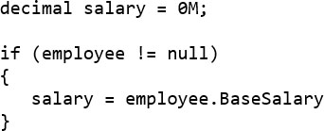
13.9.4 Null Coalescing Operator (??) (2 of 2)
More elegant and more compact than writing the following equivalent code, which must explicitly test for null:

Slide 93
13.10 Exception Filters and the C sharp 6 when Clause
Prior to
6, you could catch an exception based only on its type.
6 introduces exception filters that enable you to catch an exception based on a catch’s exeption type and a condition that’s specified with a when clause, as in
You also can specify an exception filter for a general catch clause that does not provide an exception type. This allows you to catch an exception based only on a condition, as in
The exception is caught only if the when clause’s condition is true
A typical use of an exception filter is to determine whether a property of an exception object has a specific value.

Slide 94
Common Programming Error 13.4
Following a try block with multiple catch clauses for the same type results in a compilation error, unless they provide different when clauses. If there are multiple such catches and one does not have a when clause, it must appear last; otherwise, a compilation error occurs.

Slide 95

Copyright

